Slide 1





EMPLOYEE DATABASE
ANALYSIS
Presented by: Arjun Domle

Slide 2

Problem Statement:
The organization is facing challenges in effectively managing its workforce, and there is a need for a comprehensive data analysis project to gain insights into various aspects of employee demographics, job dynamics, and tenure. The lack of detailed information hinders the ability to make informed decisions regarding talent acquisition, employee engagement, and overall workforce optimization.

Slide 3

Business Context:
This data analysis project on the employee database serves to provide valuable insights for human resources and management teams within the organization.
Understanding employee demographics, job dynamics, and tenure is crucial for making informed decisions to enhance workforce management, optimize departmental efficiency, and improve overall employee satisfaction.

Slide 4

Project Summary:
The project involves conducting a comprehensive data analysis on an employee database.
The primary objectives are to gain insights into : employee demographics, Salary Analysis, Employee Titles, Department Information, Managerial Analysis, Hiring Trends, Employee Longevity.
The database includes multiple tables such as :
employees
departments
dept_emp
dept_manager
salaries
titles

Slide 5
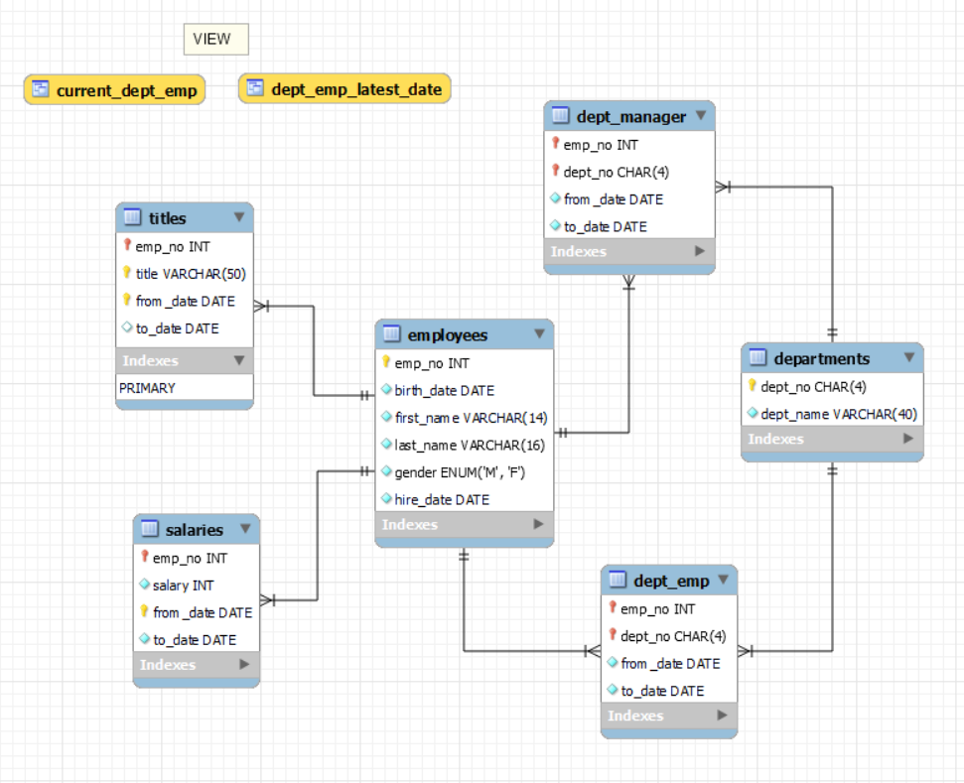

DATABASE SCHEMA
TABLES
employees
departments
dept_emp
dept_manager
salaries
titles

Slide 6

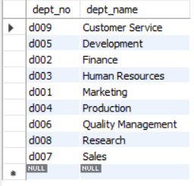
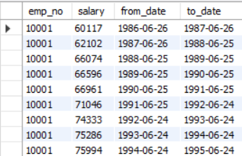
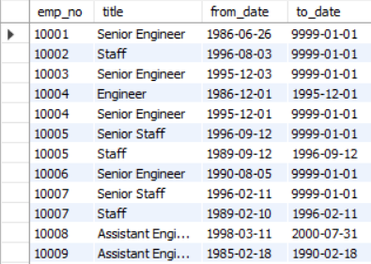
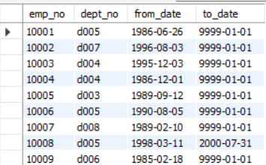
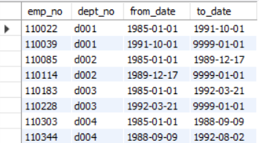
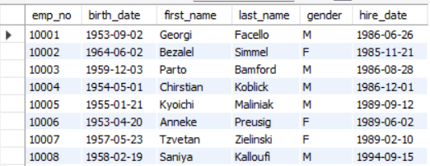
OVERVIEW OF ALL TABLES
SELECT * FROM departments;
SELECT * FROM salaries;
SELECT * FROM titles;
SELECT * FROM dept_emp;
SELECT * FROM dept_manager;
SELECT * FROM employees;

Slide 7

1.Employee Demographics:
A. What is the distribution of employees based on gender?
Asking for an analysis of the number or percentage of employees in a given dataset categorized by their gender. The purpose is to understand how the workforce is distributed among different gender categories.
B. What is the average age of employees in each department?
Asking for an analysis of the average age of employees, categorized by their respective departments. The goal is to understand the distribution of the average age across different departments within the organization.

Slide 8
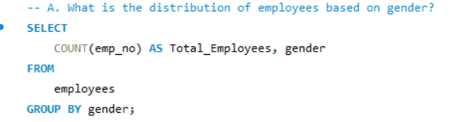
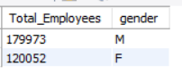
A. What is the distribution of employees based on gender?
QUERY
OUTPUT

Slide 9
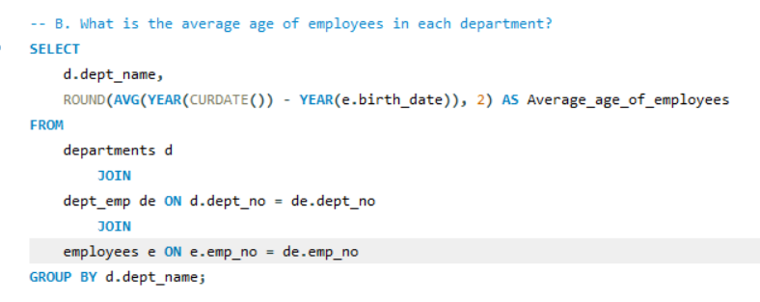
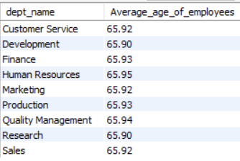
B. What is the average age of employees in each department?
QUERY
OUTPUT

Slide 10

2. Salary Analysis:
A. How has the average salary changed over the years?
Asking for an analysis of the trend or pattern in the average salary of employees over different time periods.
B. Which department has the highest average salary?
Asking for an analysis of the average salary across different departments to identify the department with the highest average salary.
C. Identify employees with the highest and lowest salaries.
Asking for a list of employees who have either the highest or the lowest salaries within the organization.

Slide 11
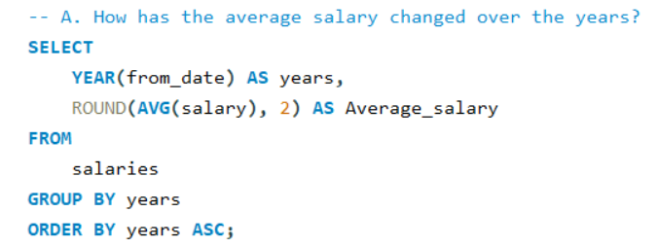
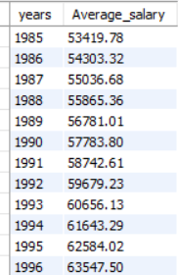
A. How has the average salary changed over the years?
QUERY
OUTPUT

Slide 12
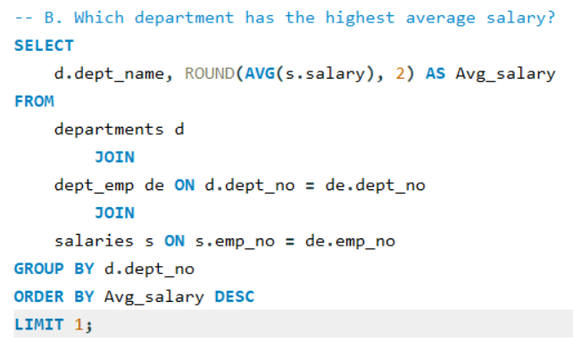
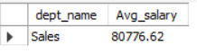
B. Which department has the highest average salary?
QUERY
OUTPUT

Slide 13
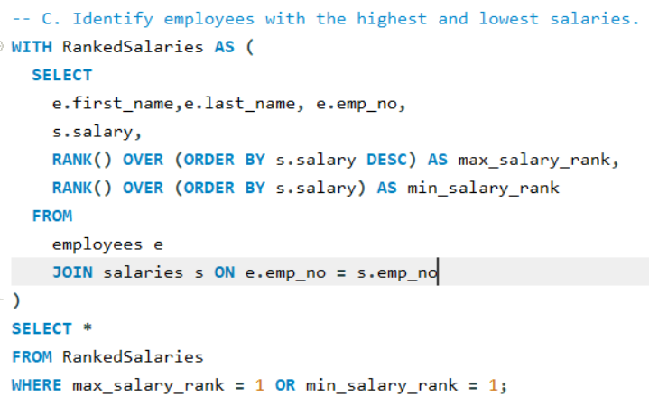
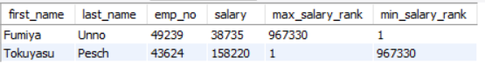
C. Identify employees with the highest and lowest salaries.
QUERY
OUTPUT

Slide 14

3. Employee Titles:
A. What are the most common job titles in the company?
Asking for an analysis of the distribution of job titles among employees to identify which job titles are most prevalent or common within the organization.
B. How often do employees change their job titles?
Asking for an analysis of the frequency or rate at which employees undergo changes in their job titles within the company.
C. Identify employees who have held the most number of titles.
Asking for an analysis of employees who have experienced frequent changes in their job titles. The goal is to identify individuals who have had a significant number of different titles throughout their employment history within the company.

Slide 15
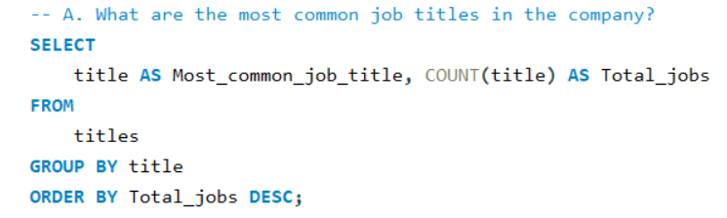
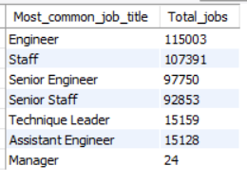
A. What are the most common job titles in the company?
QUERY
OUTPUT

Slide 16
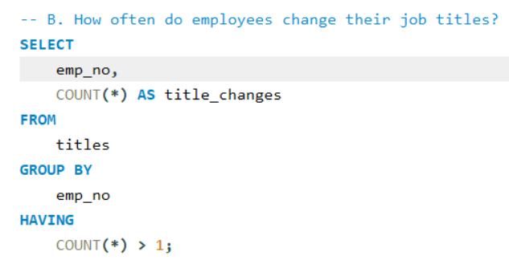
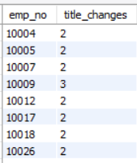
B. How often do employees change their job titles?
QUERY
OUTPUT

Slide 17
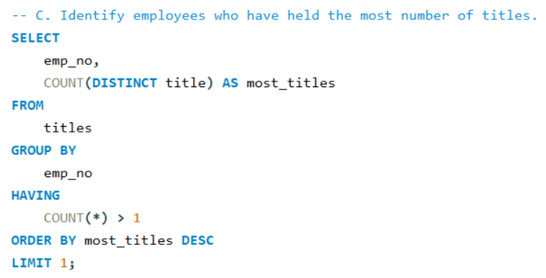
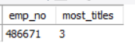
C. Identify employees who have held the most number of titles.
QUERY
OUTPUT

Slide 18

4. Department Information:
A. How many employees are currently assigned to each department?
Asking for a count of the number of employees currently associated with each department within the organization.
B. Which department has had the most managers over time?
Asking for an analysis of the historical managerial activity within each department.

Slide 19
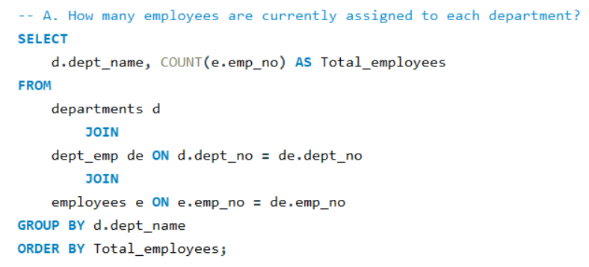
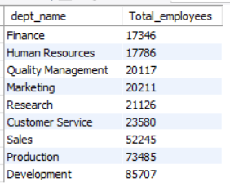
A. How many employees are currently assigned to each department?
QUERY
OUTPUT

Slide 20
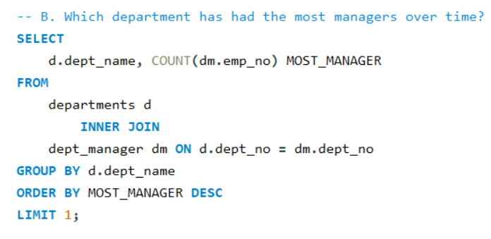
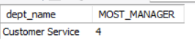
B. Which department has had the most managers over time?
QUERY
OUTPUT

Slide 21

5. Managerial Analysis:
A. Who are the current managers in each department?
Asking for information about employees who are currently serving as managers in each department.
B. How many times has each employee served as a manager?
Asking for an analysis of the managerial roles held by each employee over time.

Slide 22
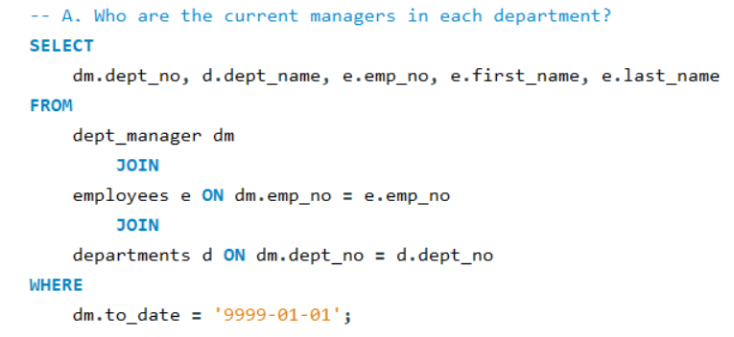
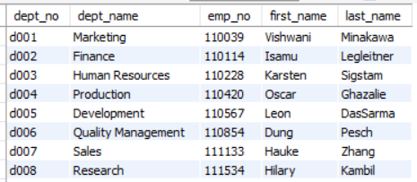
A. Who are the current managers in each department?
QUERY
OUTPUT

Slide 23
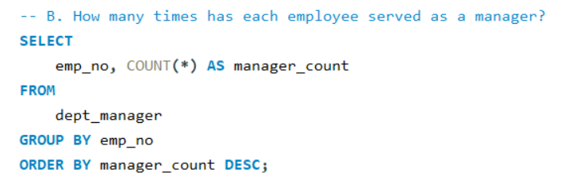
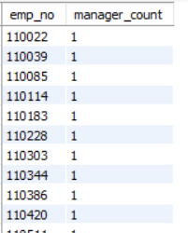
B. How many times has each employee served as a manager?
QUERY
OUTPUT

Slide 24

6. Hiring Trends:
A. How has the number of new hires changed over the years?
Asking for an analysis of the trends or patterns in the hiring activity of the organization over different years.
B. Identify the departments with the highest and lowest hiring rates.
Asking for an analysis of the relative hiring rates across different departments within the organization. The goal is to determine which departments have experienced higher or lower rates of new hires compared to their total workforce.

Slide 25
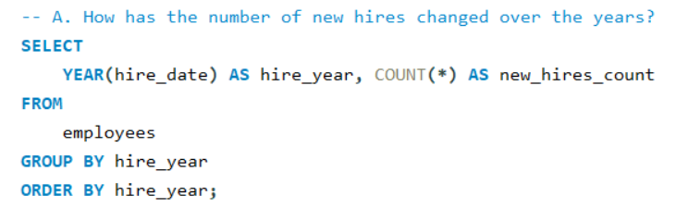
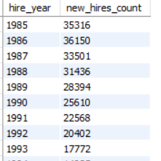
A. How has the number of new hires changed over the years?
QUERY
OUTPUT

Slide 26
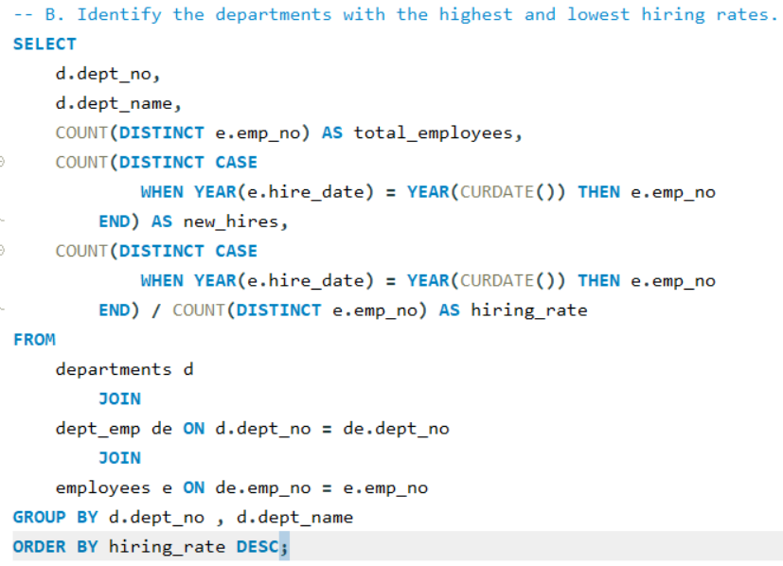
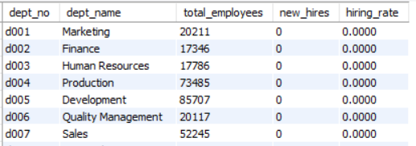
B. Identify the departments with the highest and lowest hiring rates.
QUERY
OUTPUT

Slide 27

7. Employee Longevity:
A. What is the average tenure of employees in the company?
Asking for an analysis of the average length of time that employees have been working for the organization.
B. Identify employees who have been with the company the longest.
Asking for a list of employees who have the longest tenure or have been with the company for the greatest amount of time.
C. How many employees have retired or left the company in recent years?
Asking for an analysis of the number of employees who have either retired or voluntarily left the company within a specific recent time frame.

Slide 28
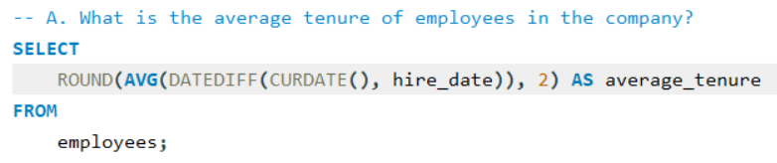
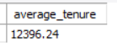
A. What is the average tenure of employees in the company?
QUERY
OUTPUT

Slide 29
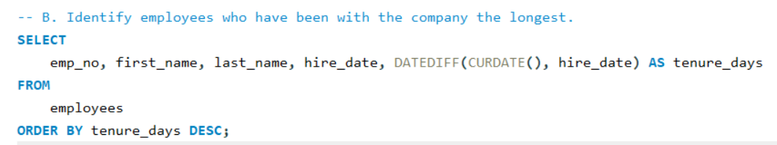
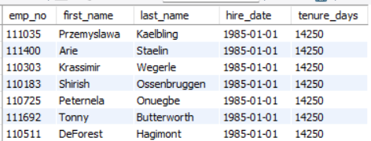
B. Identify employees who have been with the company the longest.
QUERY
OUTPUT

Slide 30
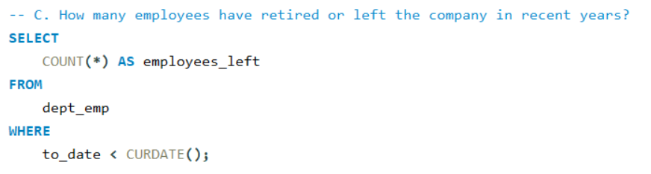
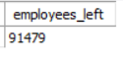
C. How many employees have retired or left the company in recent years?
QUERY
OUTPUT

Slide 31



